Slide 1
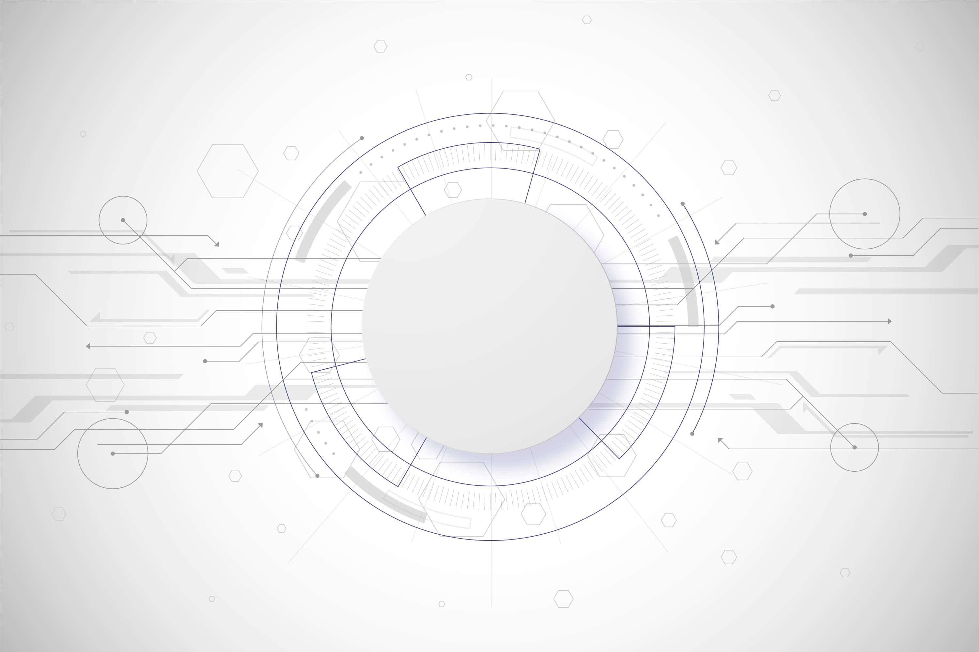
INTERNET OF THINGS
INTERNET OF THINGS
Presented By- Sarfraj Patel
(B.Tech CSE)

Slide 2

Modules
What is IOT…?
Why IOT…?
How IOT works…?
Applications of IOT.
The merits and demerits of IOT.
Future of IOT.
Conclusion.

Slide 3
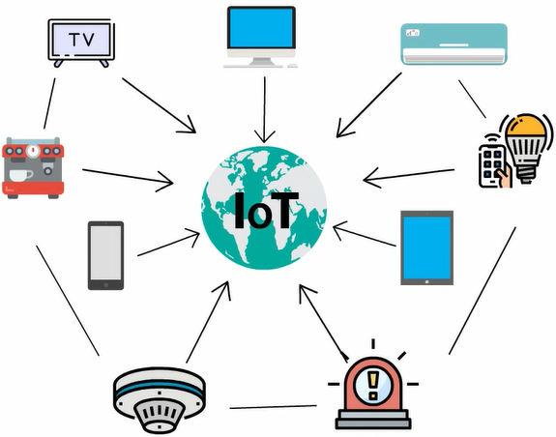
Simple Definition for IOT
The Internet of Things (IOT) is a network of physical objects.
“Things” embedded with electronics,software,sensors and network connectivity, which enables these objects to collect and exchange data (basically for data transfer between various devices over the internet) without requiring human to human or human to computer interaction.

Slide 4
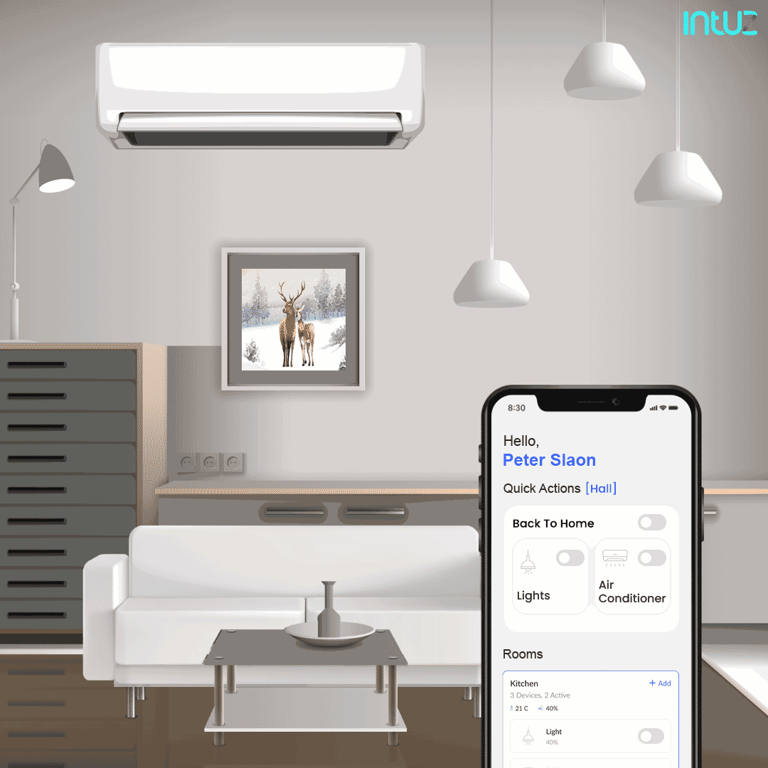
Why IOT..?
We are lazy.
We want to automate everything.
We want to control everything remotely.
We want to see data in real-time.

Slide 5
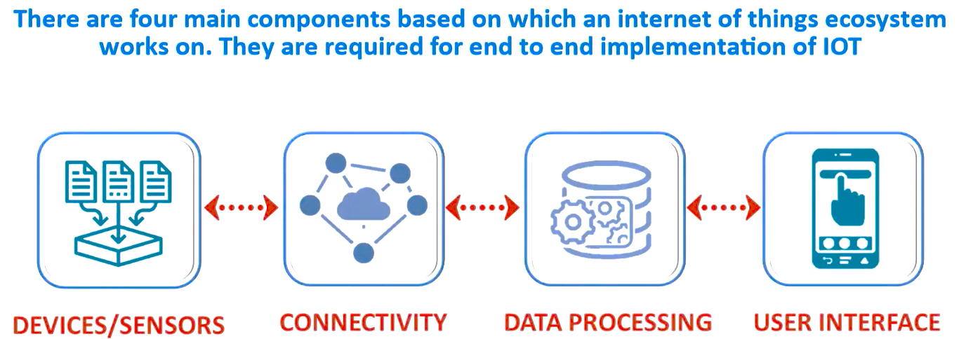
How IOT works..?

Slide 6
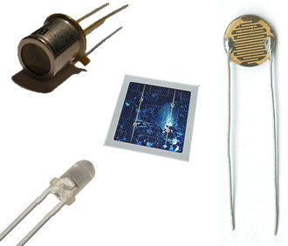
SENSORS
A sensor is a device that “sense” or measures some type of physical input from its environment and then converts that phy i/p into data that can be easily interpreted by intelligent machines or computers.
Different types of sensor - :
Light Sensor
Smoke Sensor
Sound Sensor
Motion Sensor

Slide 7
CONNECTIVITY
“IoT connectivity”, typically means the different ways in which we connect IoT devices such as actuators and sensors.
Several communication protocols and technologies are used in IOT to connect to the Internet.
Depending upon range,cost,power usage,bandwidth,etc the best connectivity is selected.
Understand that for the IOT Devices to work correctly there should be a robust connectivity between the IOT devices and the servers to which they are relying for the information.

Slide 8




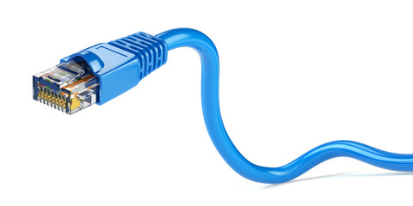
Top IOT Connectivity Technologies and Protocols

Slide 9
DATA-PROCESSING
Data is the lifeblood of IOT, but it’s useless unless we can make sense of it.
Once the raw data is collected from sensors futher it will send that data to cloud/server using some type of medium or connectivity like WI-FI.
After this, the software will perform processing on the acquired data.
It’s like turning a mountain of numbers into a clear path forward.

Slide 10
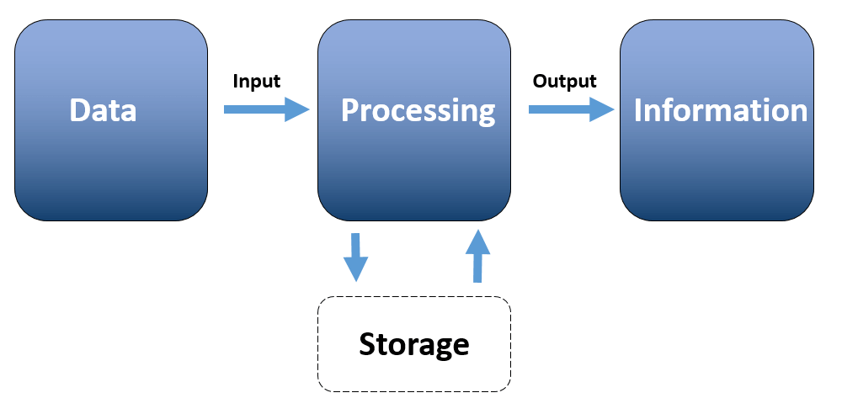
The data processing cycle consists of three stages: Input (Data), Processing (+ Storage), and Output (information).
In the first stage where data is collected and converted into a machine-readable form.
The second stage is processing. It is where data is classified into groups, arranged in an order (for example: alphabetical) and calculated (via arithmetic and logical operations).
At the third stage, the data is converted into human-readable form.
During the data processing cycle, the information is stored for future use.

Slide 11
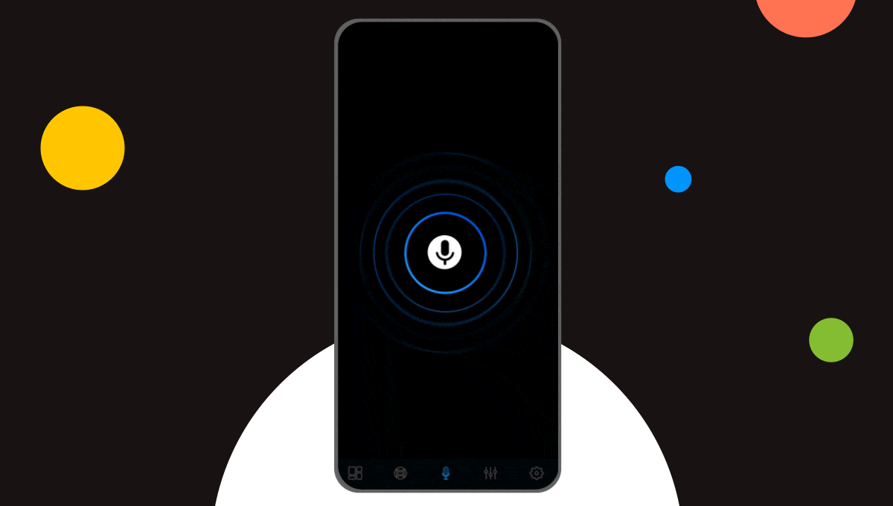
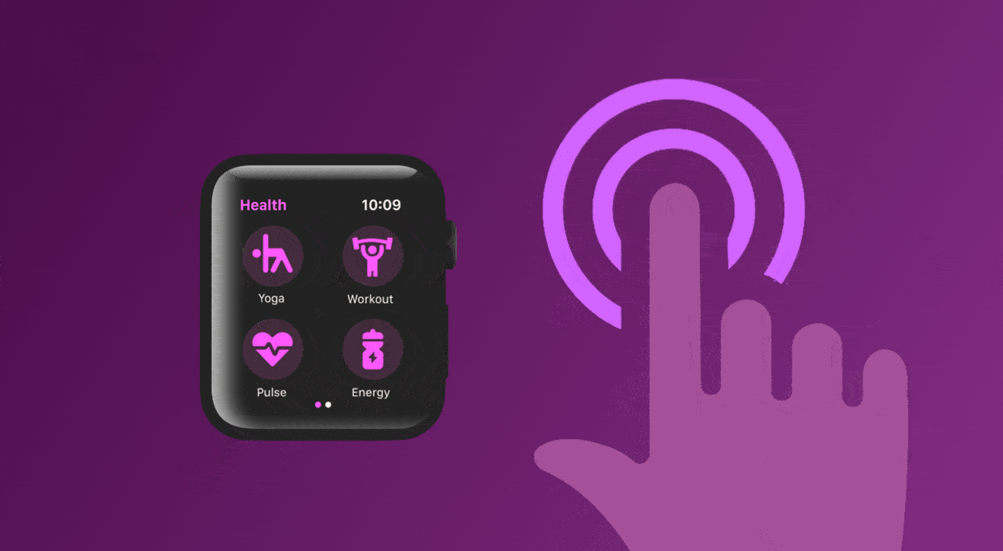
USER-INTERFACE
Finally, the information achieved is made available to the end user through UI/GUI.
User Interface, also known as UI in the Internet of Things (IoT) and provides an interface by which the users can interact with the applications and systems.
Even the most sophisticated IOT system is meaningless without an interface that users can interact with.
Here are some of the key points in the user interface of IoT : Data Visualization, User-Friendly Design, Personalization, Remote Management, Authentication and Security.

Slide 12
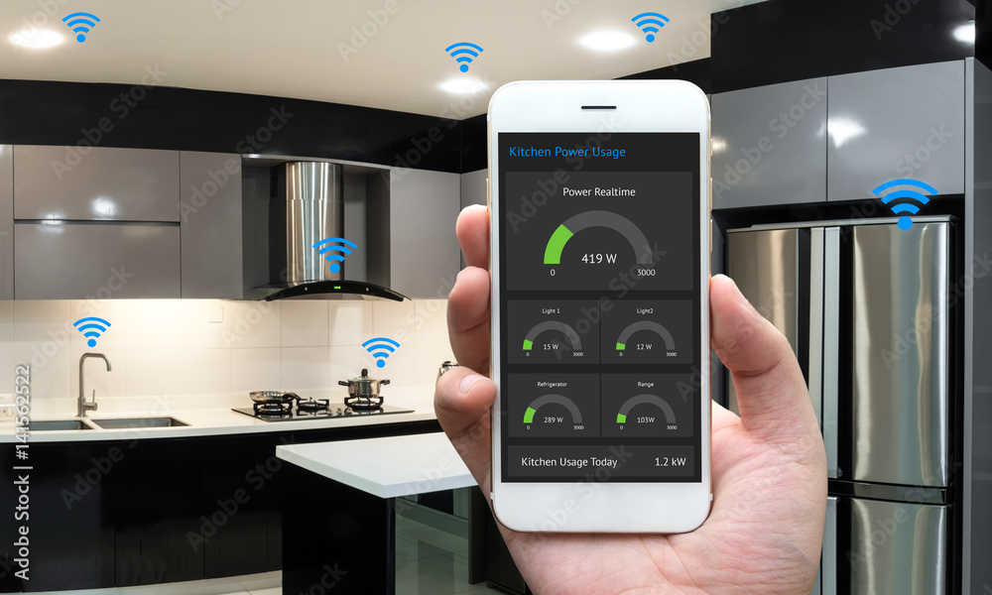
APPLICATIONS OF IOT
Smart Home Technology
Wearables

Slide 13
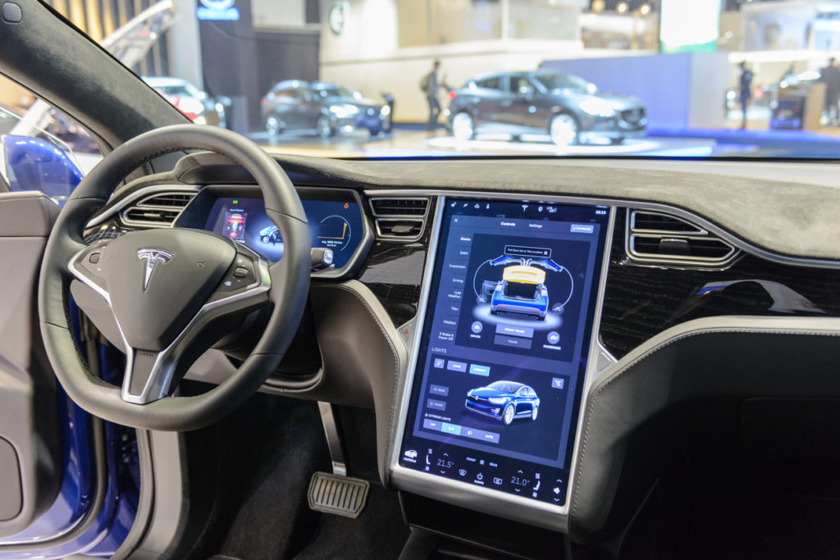
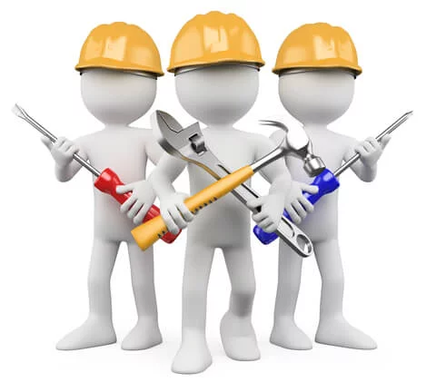
Autonomous Driving
Predictive Maintainence

Slide 14
PROS and CONS of IOT
ADVANTAGES | DISADVANTAGES
Minimize human effort and saves user time. | Security and Privacy as everything is connected to the Internet.
Easy access to information available on the Internet. | Compatibility issues with other devices.
Speed of data transfer between IoT devices. | Increased unemployment rates.

Slide 15
FUTURE OF IOT
Current State of IoT : IoT has become a driving force in industries like healthcare, transportation, retail & manufacturing & is transforming these industries like never before with the power that the future of Internet of Things holds.
Today, more than 10 billion devices are connected to the internet, & as per estimates, this number will grow to around 30 billion by 2030. With more devices connected to the internet & the rising future IoT projects.

Slide 16
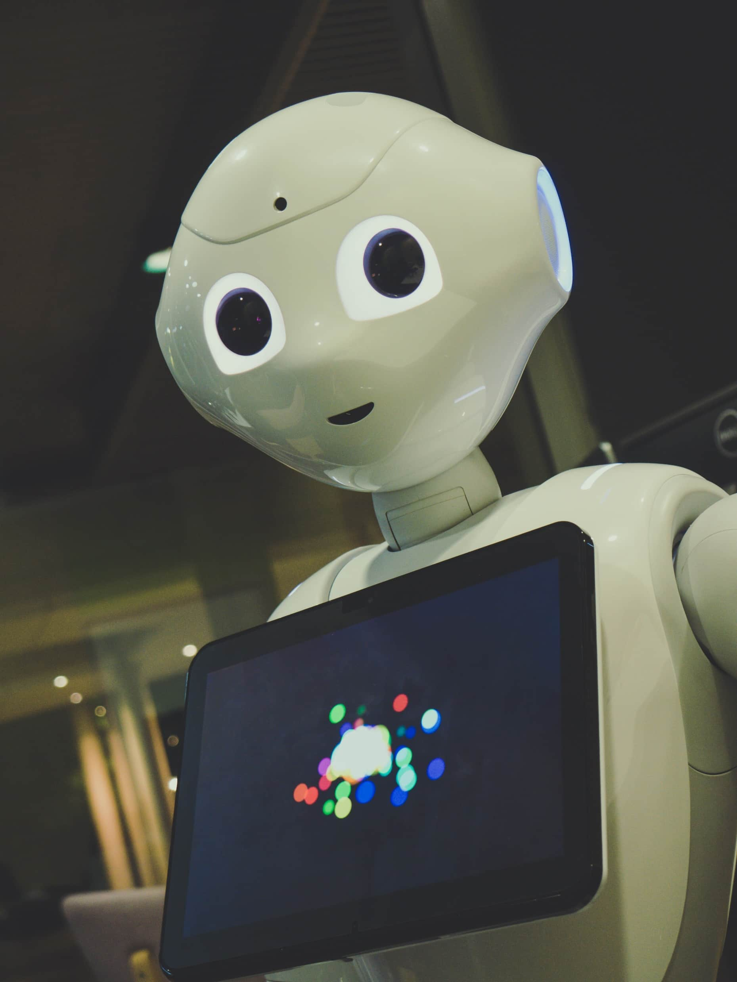
IOT + AI
AI and IoT can be combined to create intelligent machines that can simulate smart behavior and offer support in decision-making.
Such applications can assist businesses to integrate IoT and AI technologies into their future investment decisions.
IoT and Artificial Intelligence will reach more industries and business settings as they can help automate processes, reduce downtime, reduce operating costs, and increase efficiency.
Some examples of AI and IoT include self-driving cars, and robots in manufacturing.

Slide 17
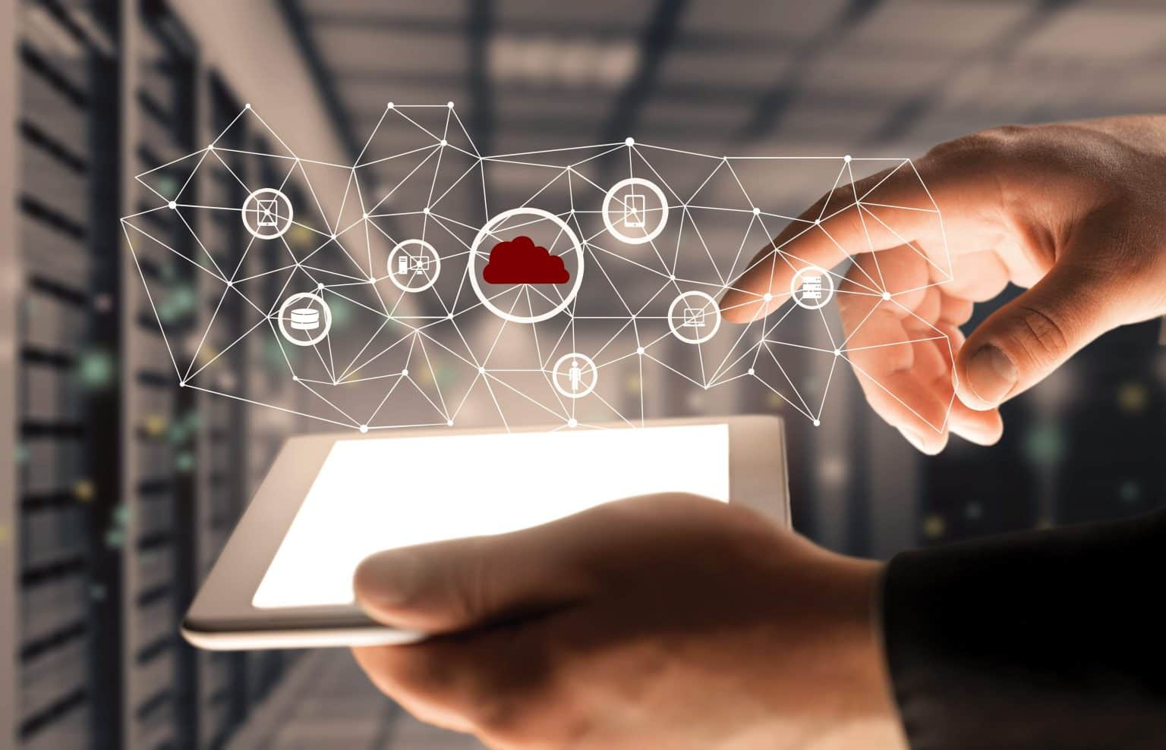
CONCLUSION
While we come to the end, IoT holds the lives of the human being straightforward and satisfactory. It has made the lives of the people very useful.
Whereas, privacy can become a huge issue in future as IoT devices are dependent on technology.
Hence, The demand for IoT engineers is increasing as more and more companies adopt IoT technology to optimize their operations, reduce costs, and improve customer experiences.
Today, there is a shortage of people with the necessary expertise and qualifications to fill these positions.

Slide 18


